Slide 1
Policy Iteration
Pick a policy Π at random

Slide 2
Policy Iteration
Pick a policy Π at random
Repeat:
Compute the reward of each state for Π U_{t+1}(i) ← R(i) + y Σ_{k}P(k | Π(i).i) U_{t}(k)

Slide 3
Policy Iteration
Pick a policy Π at random
Repeat:
Compute the reward of each state for Π U_{t+1}(i) ← R(i) + y Σ_{k}P(k | Π(i).i) U_{t}(k)
Compute the policy Π’ given these utilities Π’(i) = arg max_{a} Σ_{k}P(k | a.i) U(k)

Slide 4
Policy Iteration
Pick a policy Π at random
Repeat:
Compute the reward of each state for Π U_{t+1}(i) ← R(i) + y Σ_{k}P(k | Π(i).i) U_{t}(k)
Compute the policy Π’ given these utilities Π’(i) = arg max_{a} Σ_{k}P(k | a.i) U(k)
If Π’ = Π then return Π

Slide 5
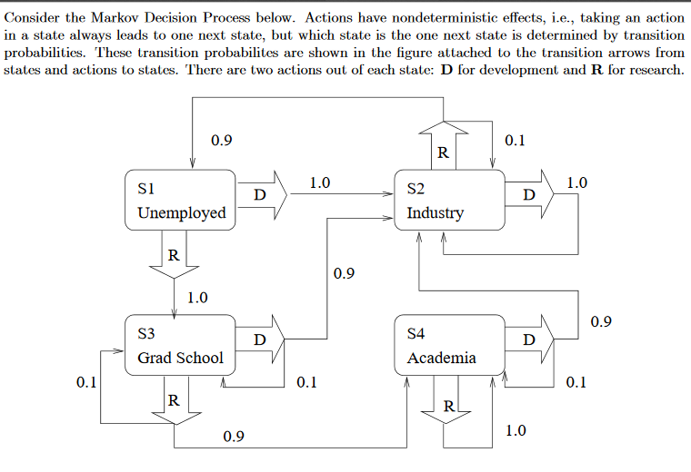
Ex 2

Slide 6
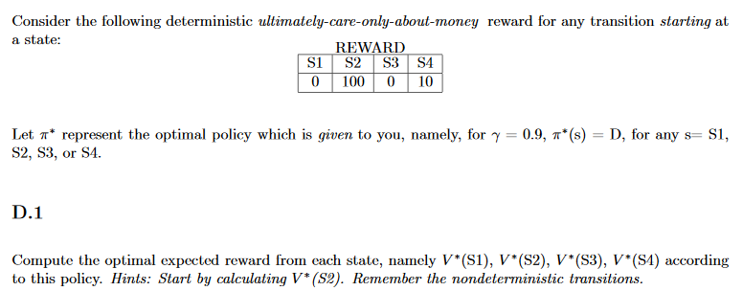

Slide 7
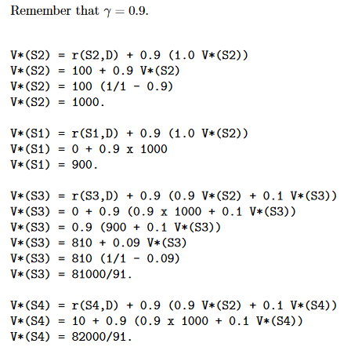
Sol 2

